Slide 1

PCA
Author: Bùi Quốc Thịnh
Principal Component Analysis

Slide 2

Team members
Bùi Quốc Thịnh - 20520934
Nguyễn Huỳnh Hải Đăng - 20521159
Vũ Quốc Thái Bình - 20521119
Lê Nguyễn Tiến Đạt - 20521167

Slide 3

Problem
What if we have a data set of genes which needs to be classified into cluster. However, we cannot determine the composition just by looking at the normal parameters with a lot of features. That is why we cannot visualize them because they are too complicated

Slide 4

Solution
We will use PCA technique, also known as Principal Component Analysis algorithm, to analyze and find the components or genes. Then select the main components from the existing genes data set

Slide 5
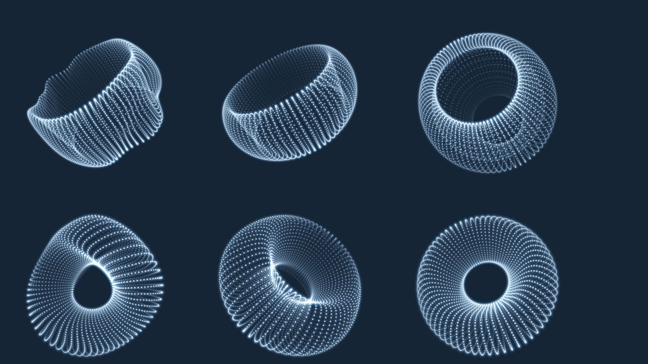
What is Principal Component Analysis?
Principal Component Analysis, or PCA, is a dimensionality-reduction method that is often used to reduce the dimensionality of large data sets, by transforming a large set of variables into a smaller one that still contains most of the information in the large set.
In order to sum up, the idea of PCA is simple — reduce the number of variables of a data set, while preserving as much information as possible.

Slide 6

Applications of PCA
Neuroscience
Quantitative Finance
Image Compression
Facial Recognition

Slide 7
How does it work?
STEP 1: STANDARDIZATION
STEP 2: COVARIANCE MATRIX COMPUTATION
STEP 3: COMPUTE THE EIGENVECTORS AND EIGENVALUES OF THE COVARIANCE MATRIX TO IDENTIFY THE PRINCIPAL COMPONENTS
STEP 4: FEATURE VECTOR
LAST STEP: RECAST THE DATA ALONG THE PRINCIPAL COMPONENTS AXES

Slide 8

Seem pretty complicated, isn’t it?

Slide 9
Comceptual motivation for PCA
 | Person 1 | Person 2 | Person 3 | Person 4 | Person 5 | Person 6
Gene 1 | 10 | 11 | 8 | 3 | 2 | 1
Gene 2 | 6 | 4 | 5 | 3 | 2.8 | 1

Slide 10
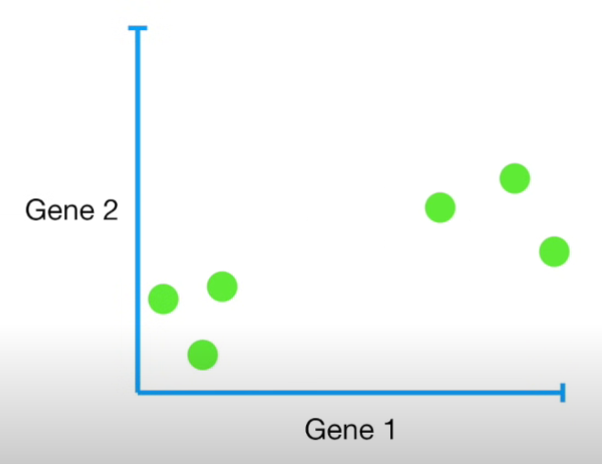

Plotting data on a number line
Plotting data on a 2D graph

Slide 11
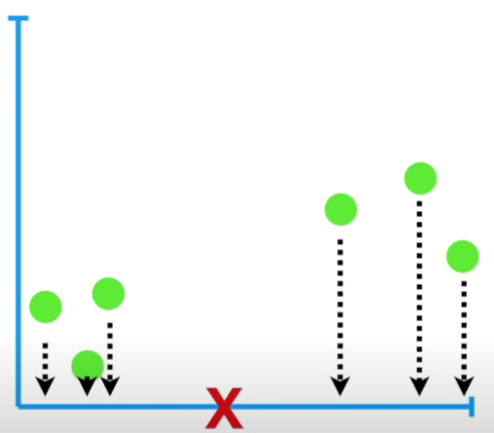
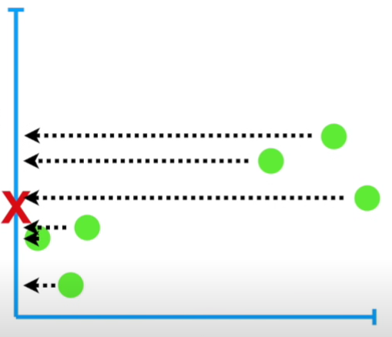
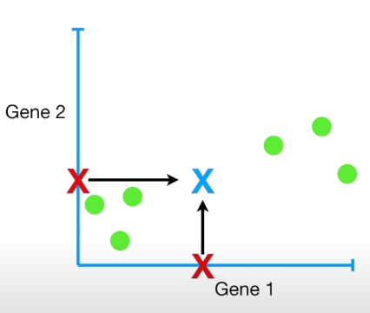
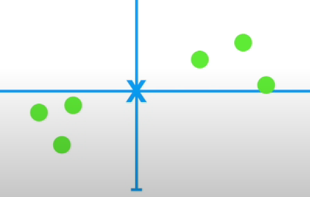
Calculate the center of the data
Average measurement for Gene 1
Average measurement for Gene 2
Center of the data
Shift to the origin

Slide 12
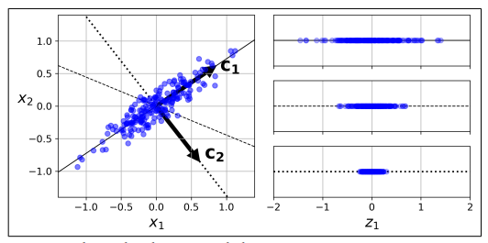
Finding PC1, PC2

Slide 13
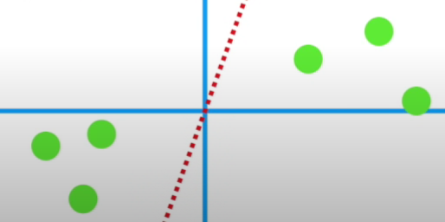
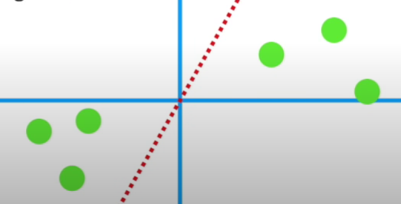
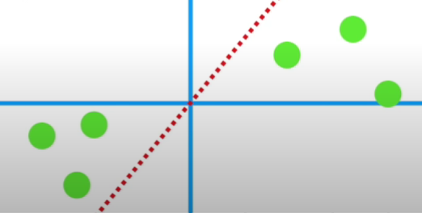
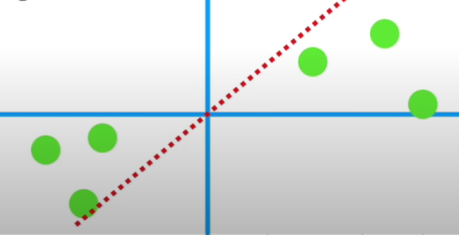
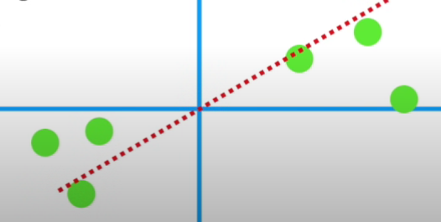
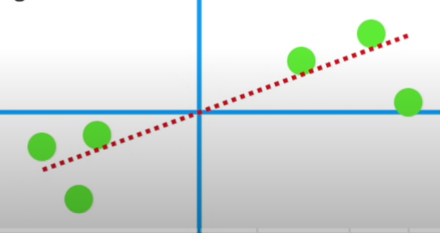
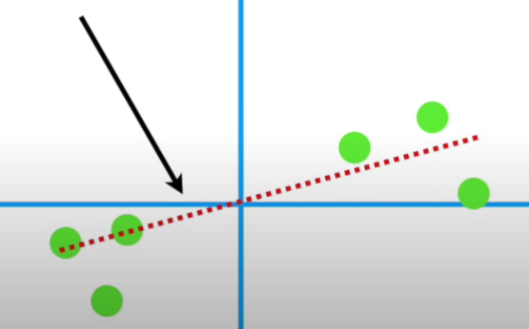
Rotate the red line until it is perfectly fit

Slide 14
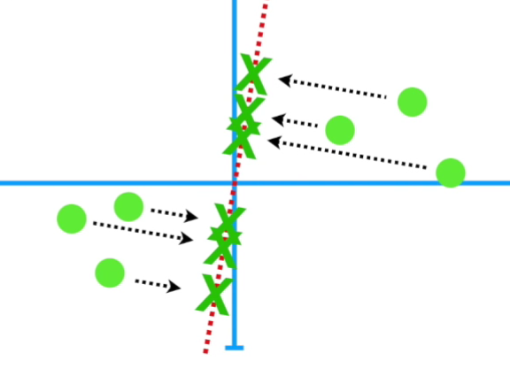
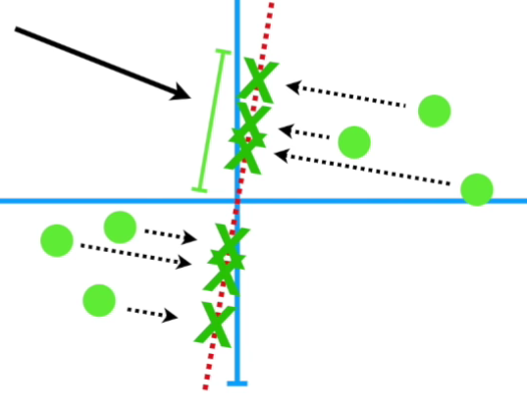
How can we know the line fits the data best?
Minimize the distance from the data to its projection on the redline
Maximize the distance from the origin to the projection points of the data to the redline

Slide 15
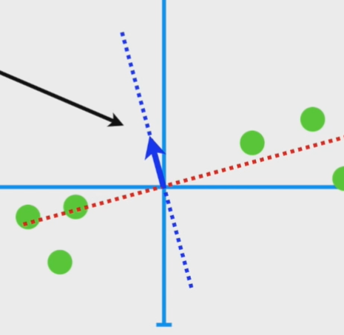
PC2 is simply just a line throught the origin that is perpendicular to PC1

Slide 16
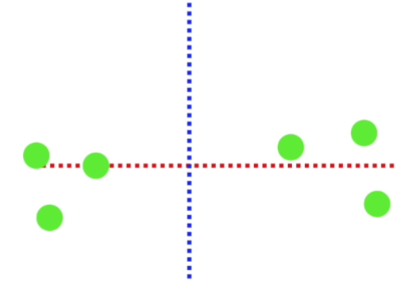
Final PCA plot
PC1 is horizontal then we use the projected points to find where the samples go in the PCA plot and PC2 is vertical

Slide 17
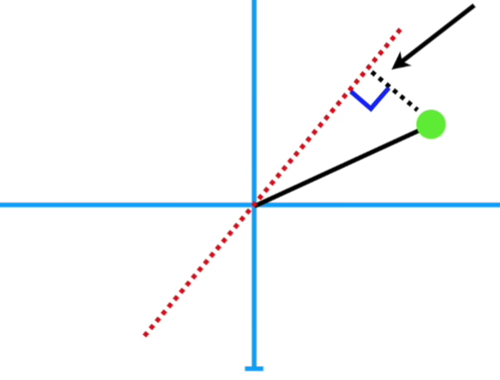
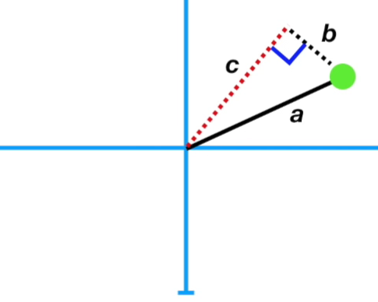
Understanding the best fitted line in a Mathematical way
a is constant
Using Pythagorean to see how b and c are inversedly related

Slide 18
Using Pythagorean to see how b and c are inversedly related
a² = b² + c²
a and a² doesn’t change. If b gets bigger then c must get smaller. Likewise, if c gets bigger then b must get smaller.

Slide 19
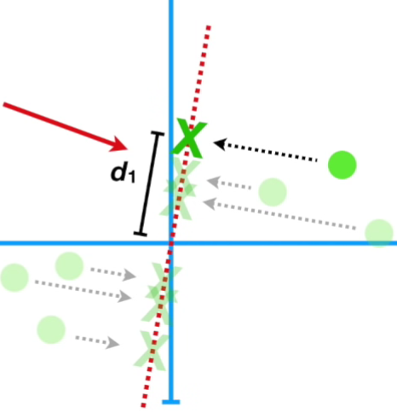

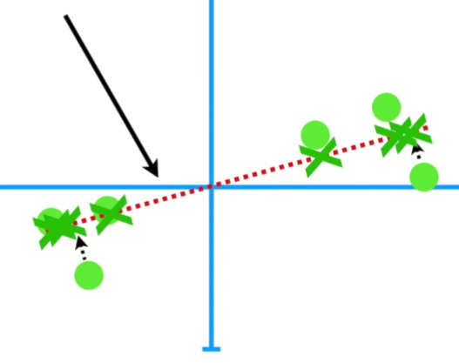
PCA finds the best fitting line by maximizing the sum of the squared distances from the projected points to the origin.
The largest sum of squared distances between the projected points and the origin.

Slide 20
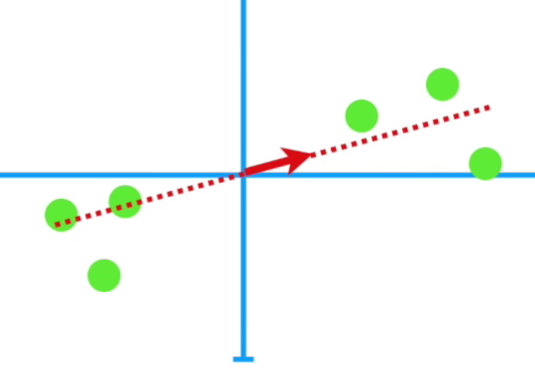
Some terminologies you need to know!!!
Sum of square distance = Eigenvalue
Square root of the Eigenvalue is called the Singular Value
Explained Variance Ratio indicates the proportion of the dataset’s variance that lies along the axis of each principal component.
The picture on the left present the Eigenvector or Singular Vector

Slide 21
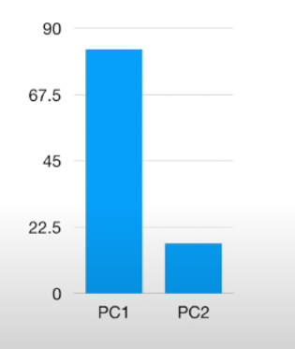
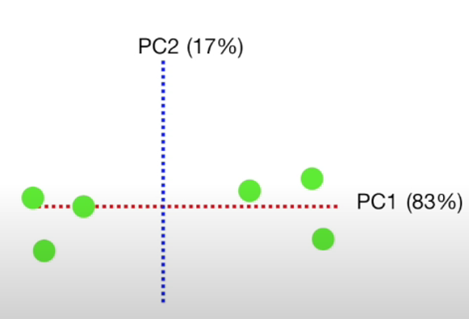
Scree Plot
A graphical representation of the percentages of variation that each PC accounts for
It is similar to Explained Variance Ratio

Slide 22

PCA is suitable for which data?
PCA is used to overcome features redundancy in a data set.
PCA works best on data set having 3 or higher dimensions. Because, with higher dimensions, it becomes increasingly difficult to make interpretations from the resultant cloud of data.
PCA is applied on a data set with numeric variables.
PCA is a linear transformation which means that it works best with linear separable data.

Slide 23
How does it actually work in real life?
1. Standardize the d-dimensional dataset. 2. Construct the covariance matrix. 3. Decompose the covariance matrix into its eigenvectors and eigenvalues. 4. Sort the eigenvalues by decreasing order to rank the corresponding eigenvectors. 5. Select k eigenvectors which correspond to the k largest eigenvalues, where k is the dimensionality of the new feature subspace ( k d ≤ ). 6. Construct a projection matrix W from the "top" k eigenvectors. 7. Transform the d-dimensional input dataset X using the projection matrix W to obtain the new k-dimensional feature subspace.

Slide 24

THE END

